Slide 1
VIZ
Adaptive Huffman (FGK) compressor
VItali Denys & SpoZio Cristian

Slide 2
Strutture dati

Slide 3
Node ed Huffman Tree
typedef struct{
Node* root;
Node* tree[HUFFMAN_ARRAY_SIZE]; // 514
Node* nyt;
char* output;
int output_length;
char* partial_output;
int partial_output_length;
int elements;
unsigned int mode;
unsigned char mask;
int decoder_flags;
unsigned int decoder_bit;
unsigned int decoder_has_bit;
int decoder_byte;
} HuffmanTree;
typedef struct Node {
int node_number;
int weight;
int element;
struct Node* left;
struct Node* right;
struct Node* parent;
} Node;
Node
Huffman Tree

Slide 4
Aggiornamento dei nodi
Inizio
No
Simbolo già presente?
Sì
NYT fa “nascere” un nuovo NYT ed un nodo esterno
Vai al simbolo
No
Incrementa il peso del nodo esterno e del vecchio NYT
Il nodo è nell’ultima posizione tra quelli del suo peso?
Scambia il nodo con l’ultimo dello stesso peso
Diagramma di flusso
Sì
Vai al vecchio NYT
Incrementa il peso del nodo
Siamo alla
root?
No
Vai al parent
Sì
Fine

Slide 5
Implementazione dell’aggiornamento
HuffmanTree* add_new_element(HuffmanTree* ht, char c){
Node* node = ht->root;
Node* target = find_node(node, c);
int* length = malloc(sizeof(int));
*length = 0;
int* path_length = malloc(sizeof(int));
unsigned short* path;
if(target != NULL){
debug("[add_new_element] AS");
path = node_path(target, path_length);
node_positioner(ht, target);
if(is_compressor(ht)){
huffman_append_partial_path(ht, path, *path_length);
}
} else {
path = node_path(ht->nyt, path_length);
if(is_compressor(ht)) {
if (ht->elements == 0) {
ht->output[0] = c;
ht->output_length = 1;
} else {
huffman_append_partial_new_element(ht, path, *path_length, c);
}
}
ht->elements++;
Node* old_nyt = ht->nyt;
if(old_nyt == NULL){
exit(51);
}
Node* new_nyt = createNYT(old_nyt->node_number - 2);
Node* new_char = createNode(old_nyt->node_number - 1, 1, c, NULL, NULL, old_nyt);
old_nyt->weight++;
old_nyt->left = new_nyt;
old_nyt->right = new_char;
old_nyt->element = -1;
ht->nyt = new_nyt;
new_nyt->parent = old_nyt;
new_char->parent = old_nyt;
ht->tree[new_nyt->node_number] = new_nyt;
ht->tree[new_char->node_number] = new_char;
target = old_nyt;
}
free(path);
free(path_length);
free(length);
while(target != ht->root){
if(target == NULL || target->parent == NULL){
return NULL;
}
target = target->parent;
node_positioner(ht, target);
}
return ht;
}

Slide 6
Node Positioner e Highest Numbered Node
Node* highest_numbered_node(HuffmanTree* ht, Node* node){
int i;
Node* highest = node;
if(node == NULL){
return NULL;
}
for(i=node->node_number+1; i<HUFFMAN_ARRAY_SIZE; i++){
if(ht->tree[i] != NULL){
if(ht->tree[i]->weight == node->weight){
highest = ht->tree[i];
}
}
}
return highest;
}
void node_positioner(HuffmanTree* ht, Node* target){
if(target == NULL){
return;
}
Node* last = highest_numbered_node(ht, target);
char buffer[250];
if(last != target && last != target->parent) {
swap_nodes(ht, target, last);
}
if(last != target->parent || target->parent == ht->root)
target->weight++;
}
Node Positioner
Highest Numbered Node

Slide 7
Swap nodes
void swap_nodes(HuffmanTree* ht, Node* node, Node* node2){
if(node == NULL || node2 == NULL){
// Null Pointer Exception
return;
}
if(node->parent == NULL || node2->parent == NULL){
// Not going to swap a root.
return;
}
if(node == node2){
// Not going to swap two identical nodes.
return;
}
if(node2->parent == node || node->parent == node2){
error("[swap_nodes] I can't swap a child with its parent");
exit(2);
}
Node* parent1 = node->parent;
Node* parent2 = node2->parent;
Node* parent1_left = parent1->left;
Node* parent2_left = parent2->left;
if(parent1_left == node){
parent1->left = node2;
} else {
parent1->right = node2;
}
if(parent2_left == node2){
parent2->left = node;
} else {
parent2->right = node;
}
// Swap Array
ht->tree[node2->node_number] = node;
ht->tree[node->node_number] = node2;
// Fix Node Numbers
int nn = node->node_number;
node->node_number = node2->node_number;
node2->node_number = nn;
node->parent = parent2;
node2->parent = parent1;
debug("[swap_nodes] End swap");
}

Slide 8
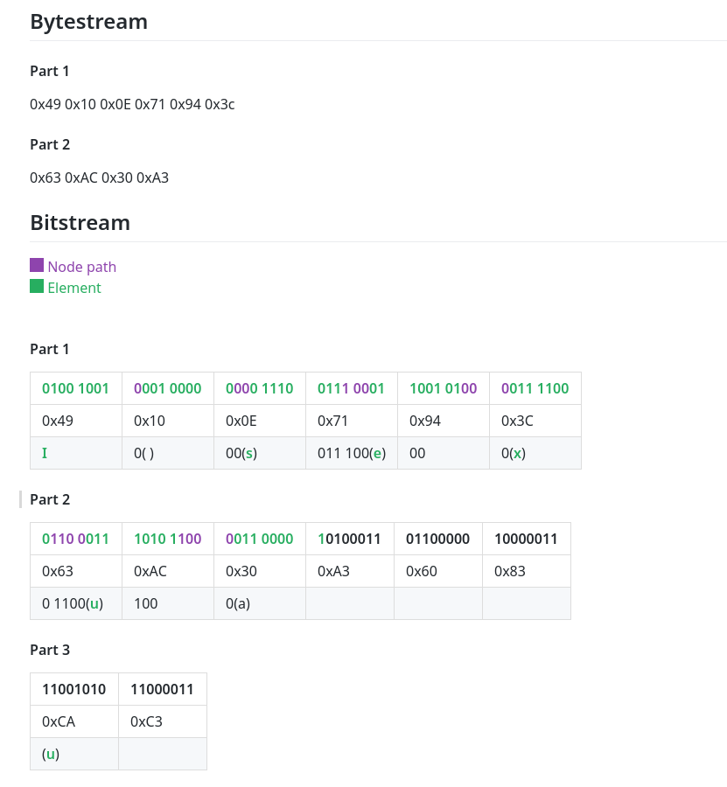
Split dei byte
void huffman_append_partial_path(HuffmanTree* ht, unsigned short* path, int path_size){
if(ht != NULL) {
debug("[huffman_append_partial_path]");
int i;
for(i=0; i<path_size; i++){
if(path[i]) {
ht->partial_output[ht->partial_output_length] |= ht->mask;
}
huffman_coding_bitcheck(ht);
}
}
}
void huffman_coding_bitcheck(HuffmanTree* ht){
if(ht->mask == 0x01){
ht->mask = 0x80;
ht->output[ht->output_length] = ht->partial_output[0];
ht->partial_output[0] = 0;
ht->output_length++;
ht->partial_output_length = 0;
huffman_coding_reset_partial_output(ht);
} else {
ht->mask >>= 1;
}
}

Slide 9
Struttura file .viz

Slide 10
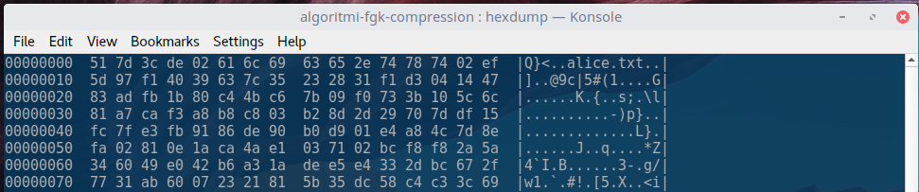
Struttura del file
Magic Number
C (02) / NC (01)
Nome file
Separatore

Slide 11
Testing

Slide 12
Framework
minunit.h - a minimal unit testing framework for C
// http://www.jera.com/techinfo/jtns/jtn002.html
#include "console.h"
#define mu_assert(message, test) do { if (!(test)) return message; } while (0)
#define mu_run_test(test) do { char *message = test(); tests_run++; \
if (message) {error_test_fail(message); return message;} test_info_end(); } while (0)
#define mu_tag(tag) test_info(tag);
extern int tests_run;
Versione modificata di minunit.h

Slide 13
I nostri test
static char * all_tests(){
mu_run_test(test_debug);
mu_run_test(test_create_huffman_tree);
//mu_run_test(test_swap_ht_array);
mu_run_test(test_huffman_coding_bookkeeper);
mu_run_test(test_huffman_coding_mississippi);
mu_run_test(test_huffman_coding_engineering);
mu_run_test(test_huffman_coding_foobar);
//mu_run_test(test_huffman_coding_foobar2000);
//mu_run_test(test_huffman_coding_loremipsum);
mu_run_test(test_get_level);
mu_run_test(test_get_node_level);
mu_run_test(test_simple_swap);
mu_run_test(test_swap_nodes);
mu_run_test(test_node_path);
mu_run_test(test_huffman_coding);
//mu_run_test(test_utility_siblings);
mu_run_test(test_huffman_coding);
mu_run_test(test_huffman_coding_abracadabra);
mu_run_test(test_huffman_coding_abcbaaa);
mu_run_test(test_huffman_coding_mississippi);
mu_run_test(test_huffman_coding_engineering);
mu_run_test(test_huffman_coding_aardvark);
mu_run_test(test_huffman_coding_sleeplessness);
mu_run_test(test_bin2byte);
mu_run_test(test_bin2byte2);
mu_run_test(test_byte2bin);
mu_run_test(test_filename);
// File ops. Run in sequence!
mu_run_test(test_create_file);
mu_run_test(test_write_to_file);
mu_run_test(test_read_file);
mu_run_test(test_file_delete);
return 0;
}

Slide 14
Esempio di test (test_byte2bin)
static char* test_byte2bin(){
mu_tag("Byte2Bin");
unsigned short* result;
result = byte2bit('\xff');
unsigned short* expected_result = (unsigned short[8]){1,1,1,1,1,1,1,1};
mu_assert("FF is not 11111111", compare_short_int(result, expected_result, 8));
free(result);
result = byte2bit('\xfa');
expected_result = (unsigned short[8]){1,1,1,1,1,0,1,0};
mu_assert("FA is not 11111010", compare_short_int(result, expected_result, 8));
free(result);
result = byte2bit('\x0a');
expected_result = (unsigned short[8]){0,0,0,0,1,0,1,0};
mu_assert("0A is not 00001010", compare_short_int(result, expected_result, 8));
free(result);
result = byte2bit('\x00');
expected_result = (unsigned short[8]){0,0,0,0,0,0,0,0};
mu_assert("00 is not 00000000", compare_short_int(result, expected_result, 8));
free(result);
return 0;
}
...
➡ Testing "Huffman Coding (mississippi)"
⬆️ Test completed
➡ Testing "Huffman Coding (engineering)"
⬆️ Test completed
➡ Testing "Huffman Coding (aardvark)"
⬆️ Test completed
➡ Testing "Huffman Coding (sleeplessness)"
⬆️ Test completed
➡ Testing "Write to file"
⬆️ Test completed
➡ Testing "Read file"
File size is: 5
⬆️ Test completed
➡ Testing "Delete file"
⬆️ Test completed
✓ ALL TESTS PASSED
Tests run: 27

Slide 15
Problemi riscontrati
Swap dei nodi nell’ HT Array
Split dei byte
Decompressione (WIP)

Slide 16

Jenkins
Continuous Integration
&
Automation

Slide 17
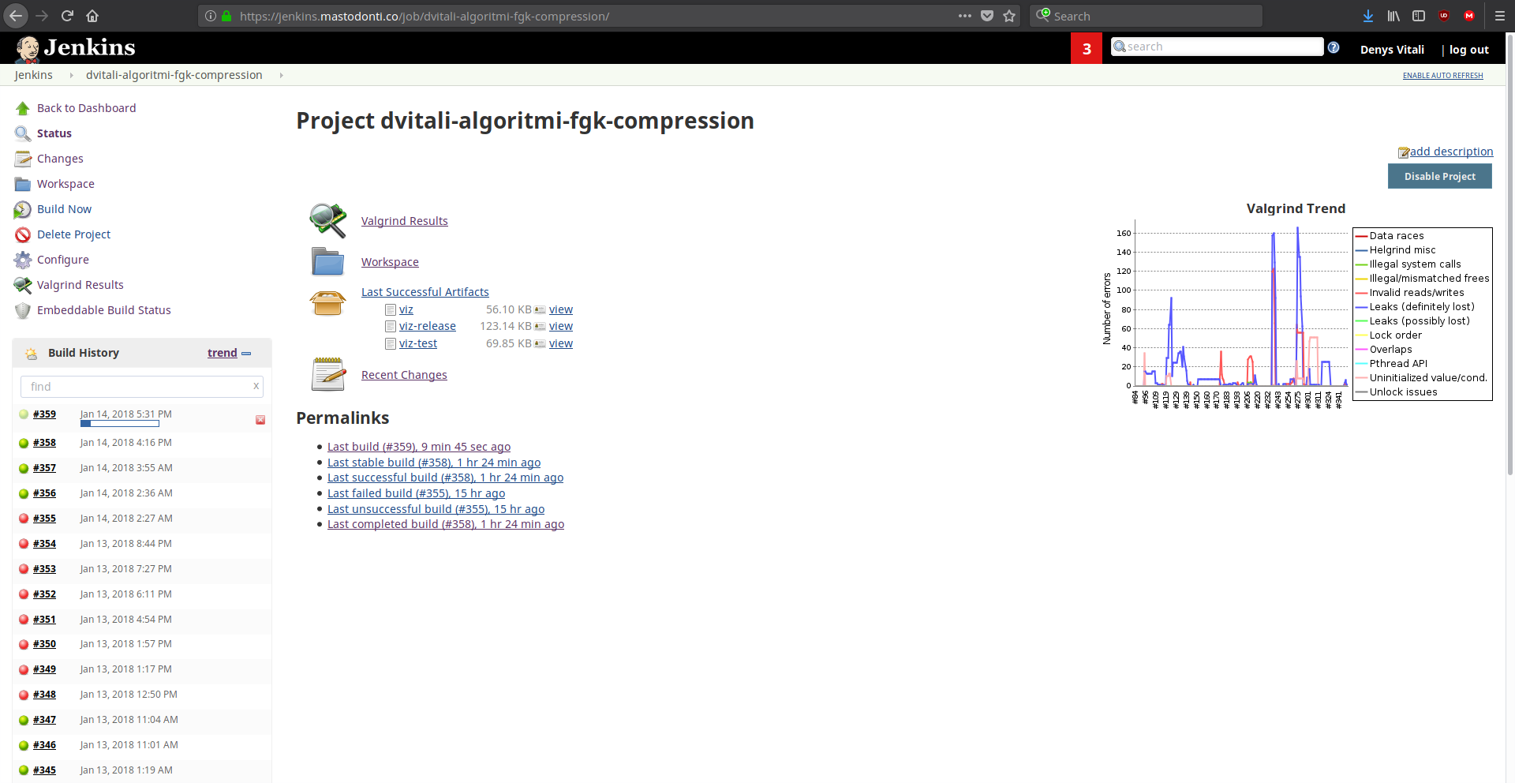
Automatic Builds

Slide 18
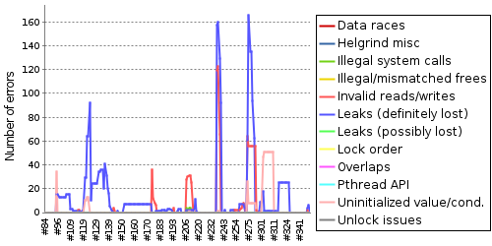
Valgrind

Slide 19
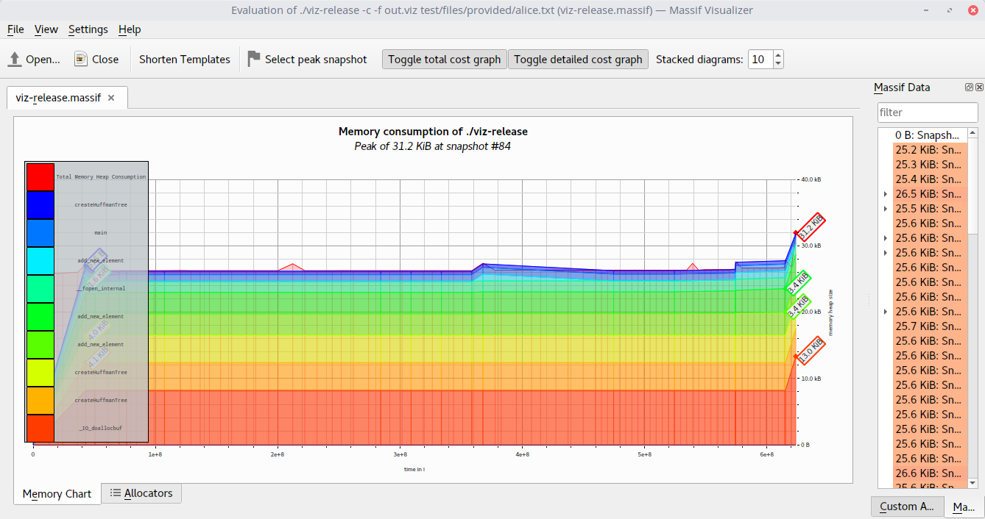
Massif - Memory Visualizer
make massif_release (make massif_release_c)

Slide 20
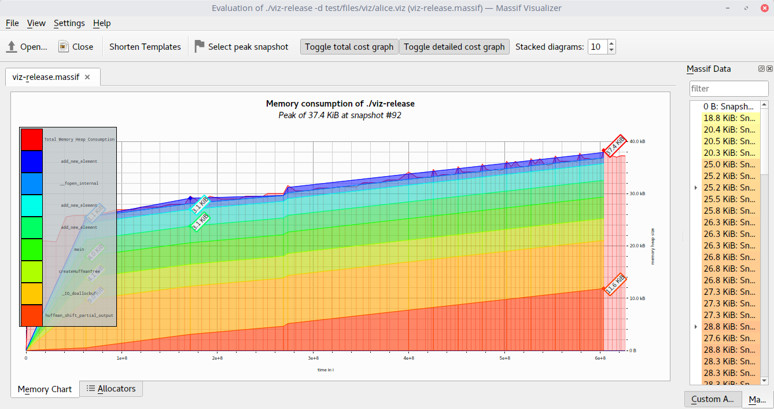
Massif - Memory Visualizer
make massif_release_d

Slide 21
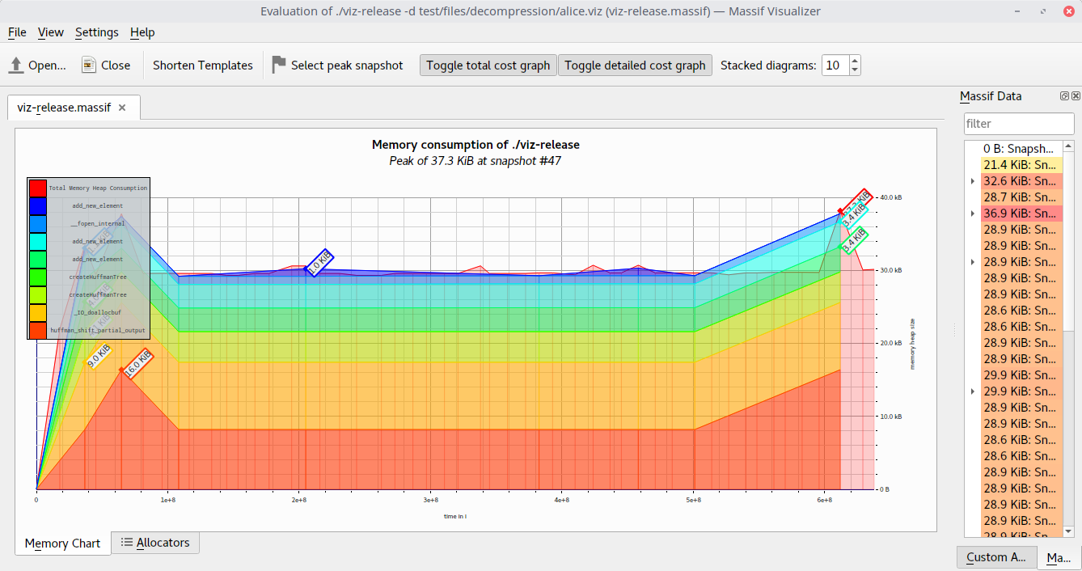
Massif - Memory Visualizer
make massif_release_d - after optimization

Slide 22
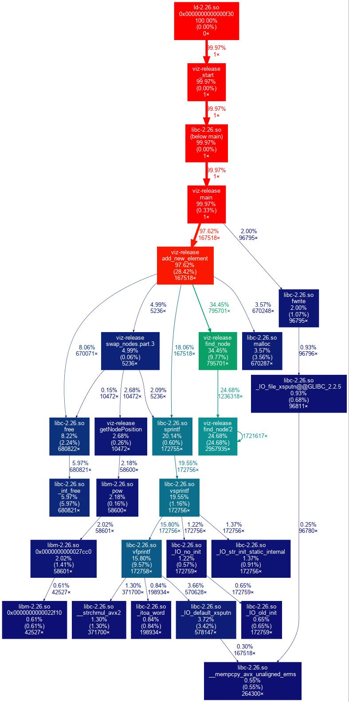
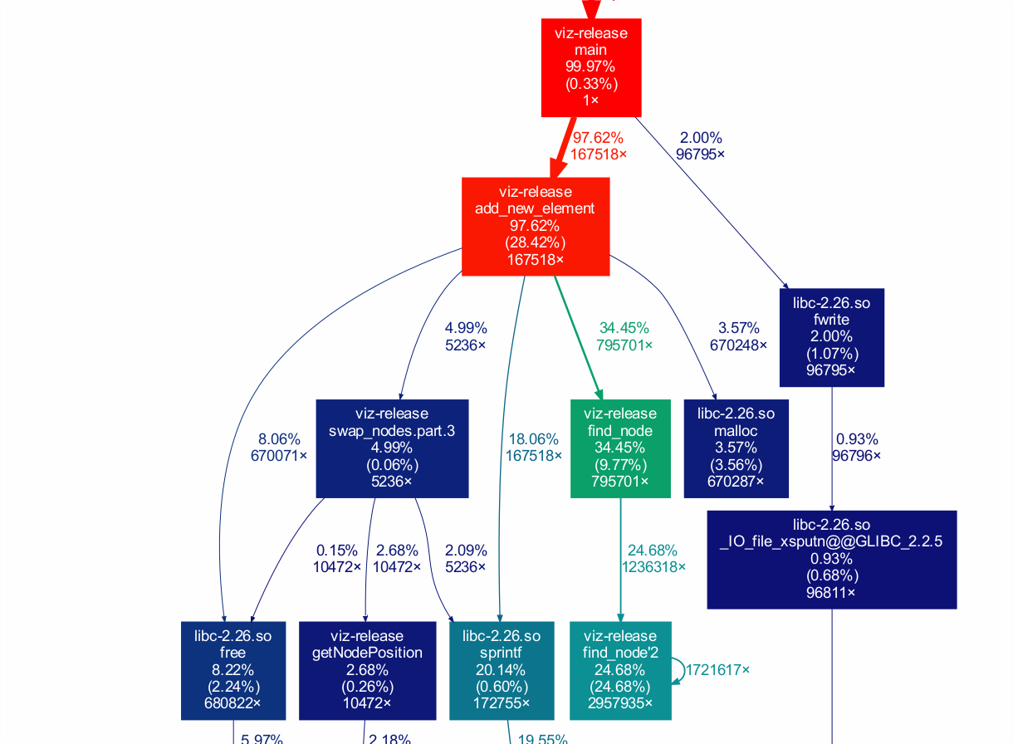
Callgrind - Call graph
make callgrind_release (make callgrind_release_c)

Slide 23
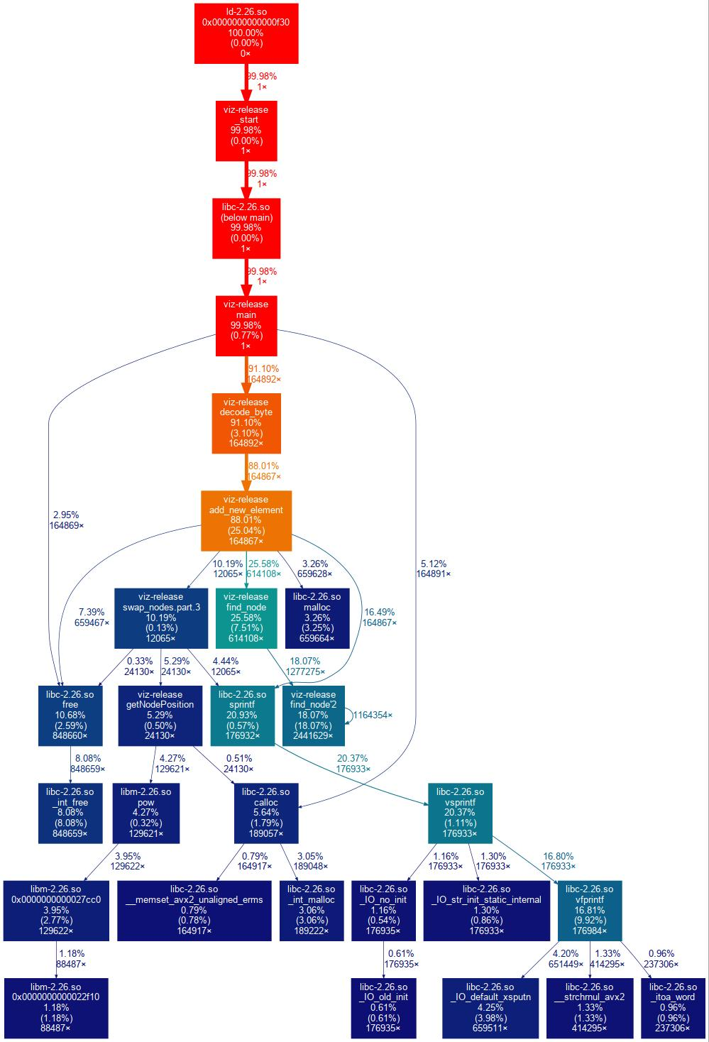
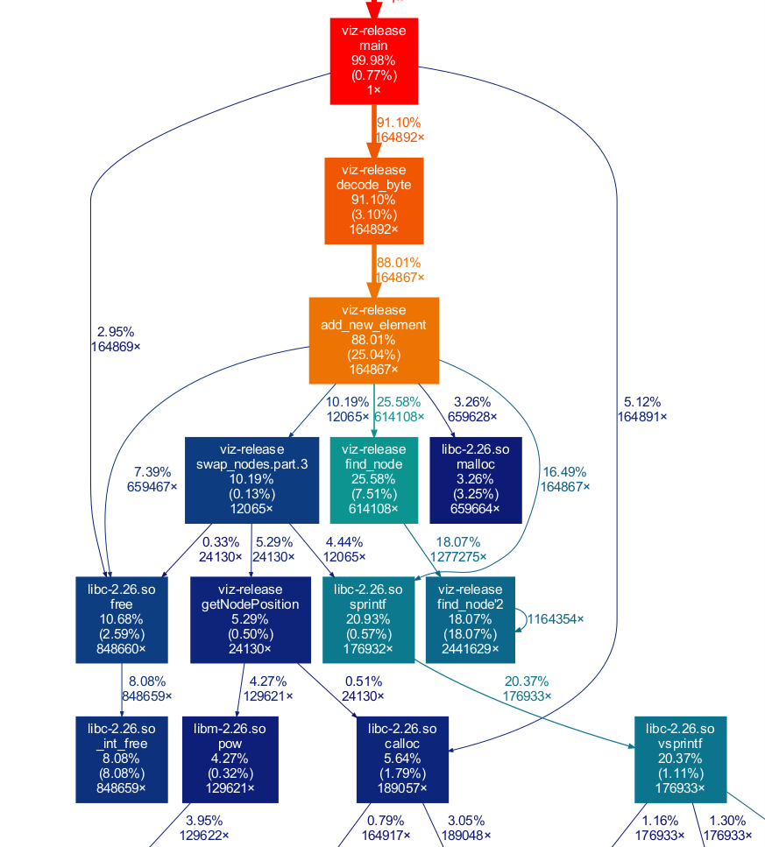
Callgrind - Call graph
make callgrind_release_d

Slide 24
Benchmark

Slide 25
800 kB/s
Velocità media di compressione
147MB compressi in 189.42s (153875545/189.42/1024 = 793.311 kB/s)
Intel Core i7-6700HQ @ 8x 3.5GHz, 32GB RAM, x86_64 Linux 4.14.13-1

Slide 26
35%
Fattore di compressione medio
*Ottenuto con una media del rapporto di compressione dei file:
immagine.tiff, fitnessgram.txt, adaptivehuffman.txt, alice.txt, bible.txt, 32k_ff

Slide 27
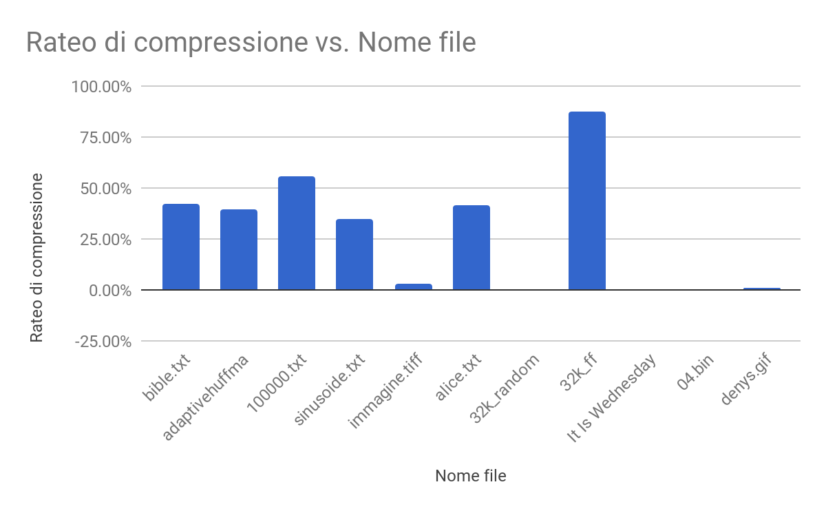

Slide 28
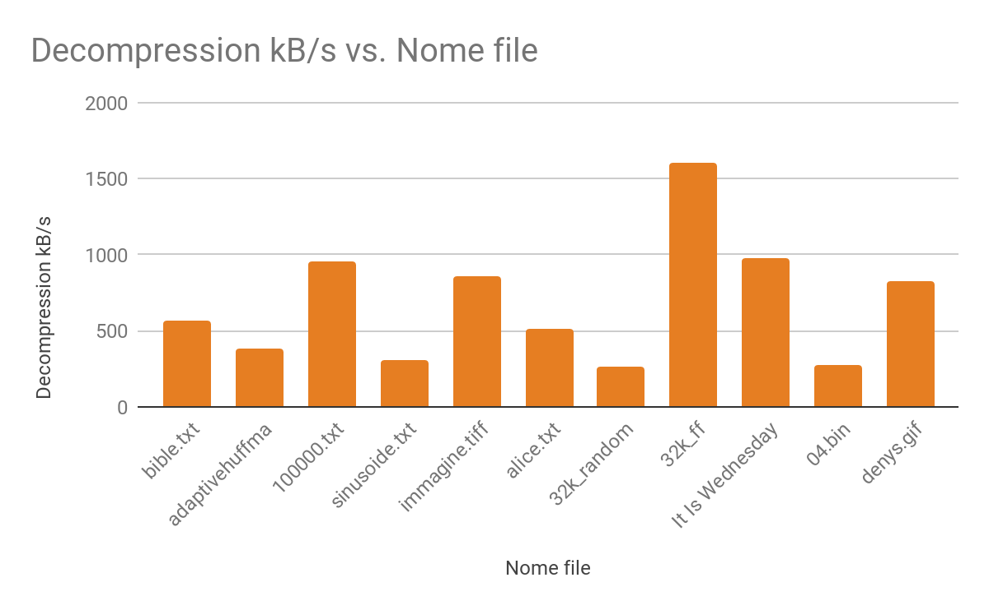

Slide 29
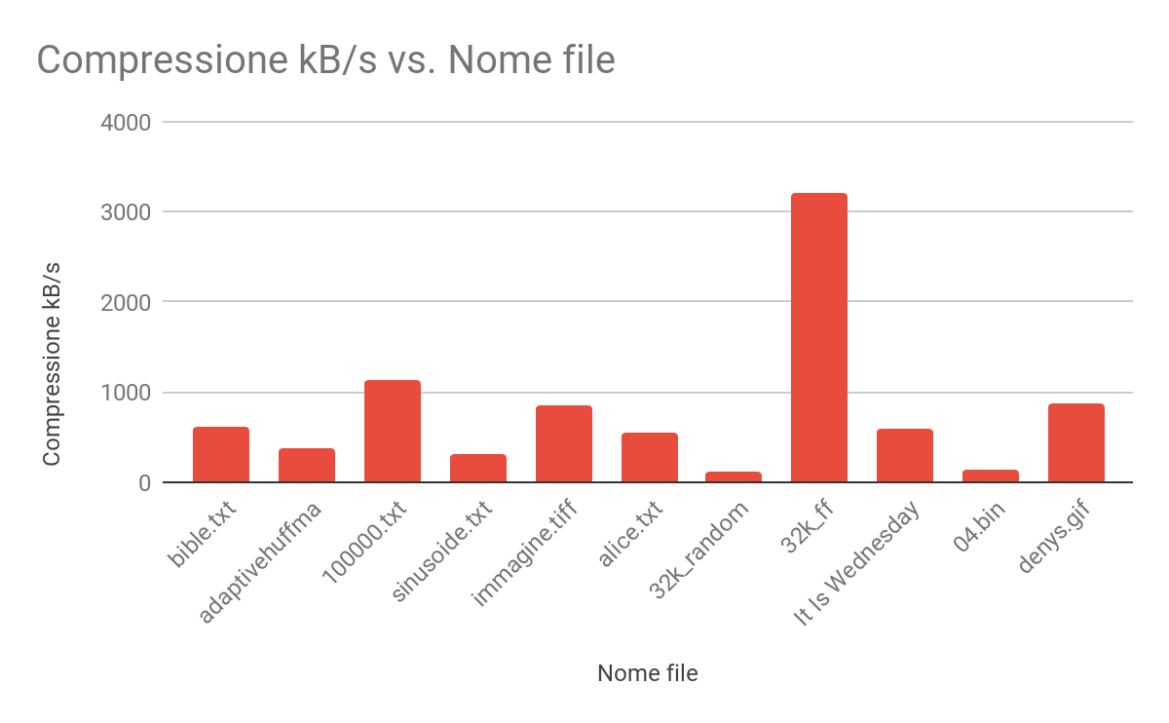

Slide 30
